Slide 1
Nathan Snyder
Apr. 9, 2021
Neural net architecture:
2 layers with 70 nodes each
Hyperparameter search methodology:
Grid search over different optimizers and learning rates:
8 optimizers: Adadelta, Adagrad, Adam, Adamax, Ftrl, Nadam, RMSprop, and SGD
6 learning rates: 0.001, 0.005, 0.01, 0.05, 0.1, and 0.5
This week I only tested the Adam optimizer over all 6 learning rates

Slide 2
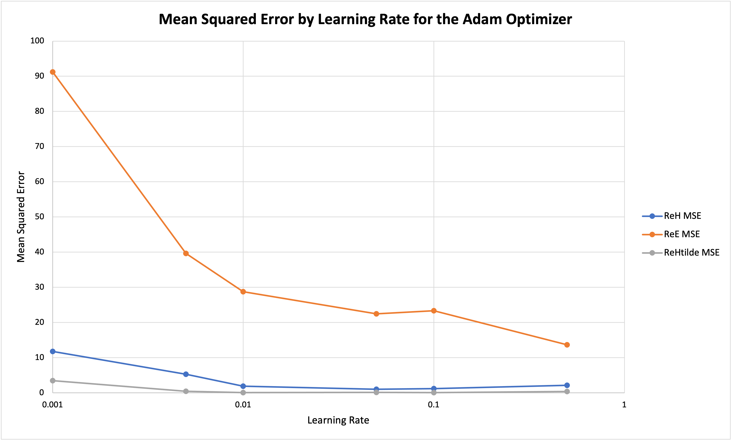

Slide 3
Takeaways
ReE was always computed with significantly more error than ReH and ReHtilde
Most likely due to the architecture of the model
For ReH and ReHtilde, the optimal learning rate was between 0.01 and 0.1
Need to test more learning rates in this range to get a smaller bound for the optimal learning rate.
The shape of the ReE MSE plot was not a U-shape like the other ones
According to the data, the optimal learning rate for ReE is 0.5
This could just be an outlier since I only ran the model once

